Slide 1
PROJECT TITLE
CAPSTONE PROJECT
Secure Data Hiding in Images Using Steganography
Presented By:
Student Name : JUJJAVARAPU RAJA SEKHAR
College Name & Department : Jawaharlal Nehru Technological University, Kakinada

Slide 2
OUTLINE
Problem Statement
Technology used
Wow factor
End users
Result
Conclusion
Git-hub Link
Future scope

Slide 3
Problem Statement
How do we maintain secure communication in a world where cyber attacks are on the rise? Conventional encryption techniques are vulnerable to hackers, so it is important to look into other methods. Is steganography enough to conceal encrypted messages behind images in such a way that they cannot be detected by unauthorized users?

Slide 4
Technology used
Programming Language: Python
Tools: Steganography Tool, Python Libraries
Libraries Used: OpenCV2, NumPy,

Slide 5
Wow factors
Improved Security: The secret message is encrypted prior to its insertion into the image, thus making it even more difficult to detect or decrypt.
Invisible Communication: Contrary to conventional encryption, steganography does not generate attention, since the message is concealed within an image file.
Imperceptible Data Hiding: The quality of the image is not significantly altered after the insertion of the encrypted message, making the alteration unnoticeable.
Python-Based Execution: Employs strong libraries such as OpenCV, NumPy, to perform optimized image processing and data embedding.
Lightweight & Quick Execution: The project quickly hides and reveals messages without growing the image file size appreciably.
Scalable Implementation: This application can be integrated to videos, audio files, and other computer media for the secure hiding of data.
Practical Applications in Real Life: Can be implemented for secure army communication, watermarking digital material, securing important data, and whistleblower communication.

Slide 6
End users
Cybersecurity Experts: Create secure communication protocols and cryptographic studies.
Government & Military: Protect defense and intelligence communications.
Journalists & Whistleblowers: Safely transmit sensitive content while maintaining anonymity.
Businesses & Corporations: Defend against data breaches and corporate espionage.
Privacy-Savvy Individuals: Securely transmit personal and financial data.
Law Enforcement: Employ in forensic analysis and covert operations.
Digital Content Creators: Secure intellectual property using covert watermarks.

Slide 7
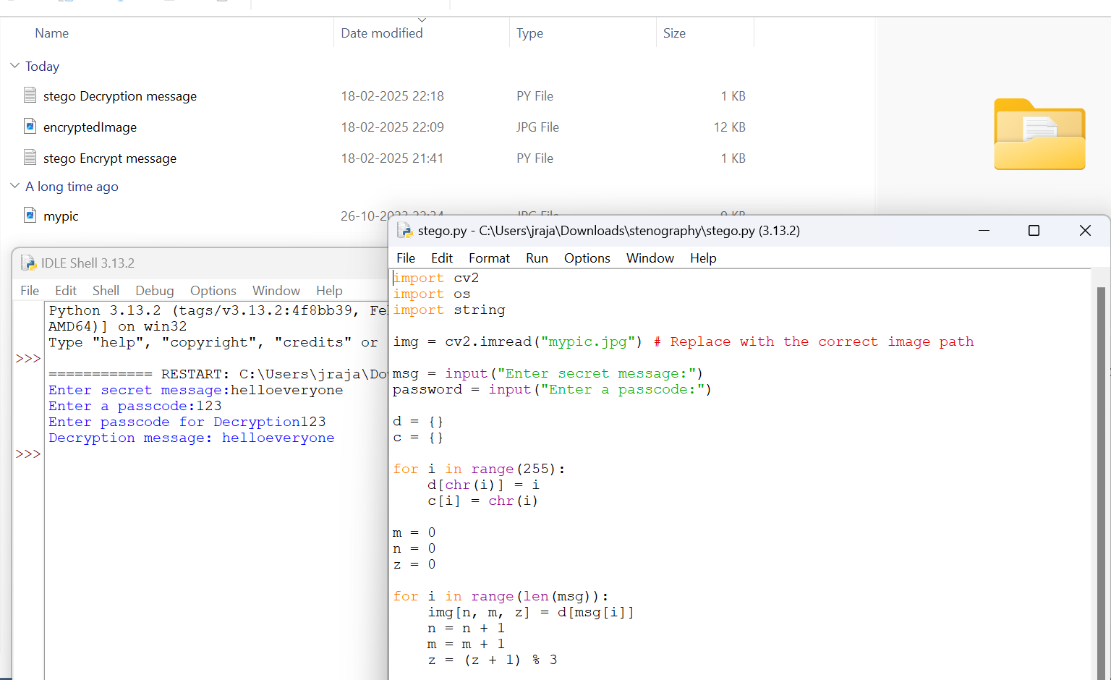
Results

Slide 8
Conclusion
This project effectively illustrates the application of steganography in secure data hiding from images. The integration of encryption and steganography provides a double layer of protection, rendering hidden messages almost undetectable. The implementation using Python effectively embeds and retrieves encrypted messages without compromising the quality of the image. The method is extremely helpful for secure communication, data security, and excluding unauthorized access. With its uses in cybersecurity, digital forensics, and secure communication, this project demonstrates the power of steganography as a useful security tool. Potential future improvements might involve extending the technique to video, audio, and real-time encryption systems for even more applications.

Slide 9
GitHub Link
Make sure that there should be readme file
https://github.com/Raja200219/My-Project-AICTE.git

Slide 10
THANK YOU
Implemented a Python-based steganography tool to hide and extract encrypted messages in images. Used OpenCV, NumPy for processing while ensuring security and image quality.

